Slide 1
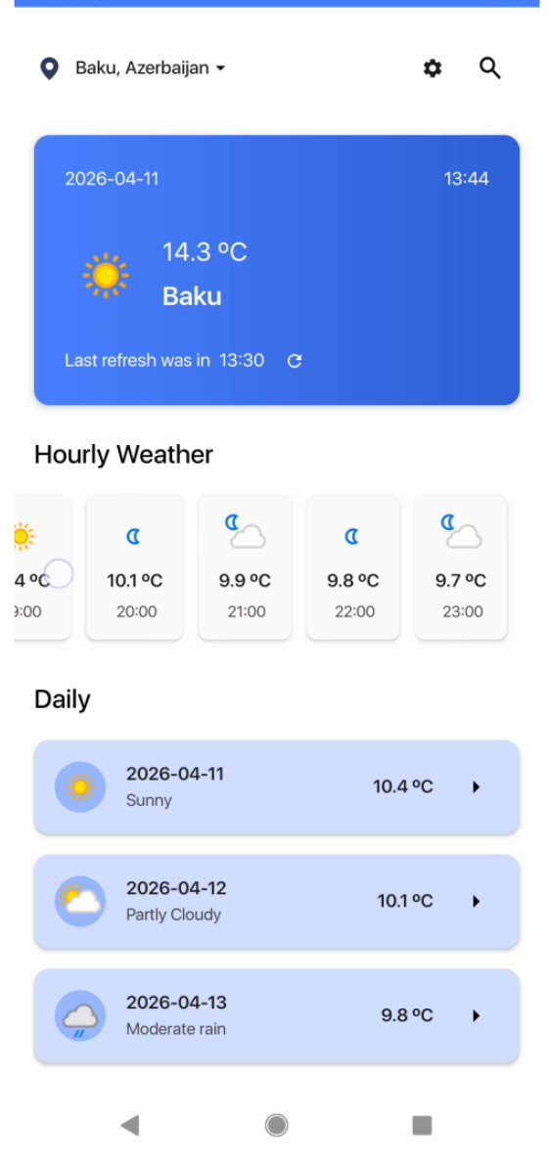
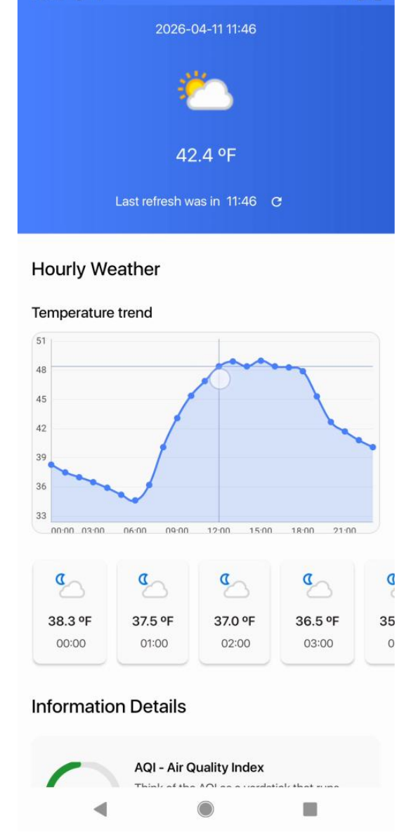
WoWeather
Android Weather Application
Bachelor’s Thesis Defence
Ravan Aliyev · University of Łódź · 2026
A native Kotlin app that retrieves weather data, stores user preferences, and presents forecasts through a structured multi-screen interface.
☀️ 🌧️ 🌙
WoWeather thesis defence | 01
Notes:
Introduce the project: WoWeather is a native Android weather application built for the bachelor thesis. Emphasize that the defence will focus on the implemented product, architecture, validation, limitations, and future improvements.

Slide 2
Context
Problem & project purpose
Weather apps must combine remote data, local user choices, and clear UI behaviour when connectivity changes.
WeatherAPI.com
forecast source
• Retrieve forecast information reliably from an external REST service
• Present current, hourly, and multi-day data in a readable mobile interface
• Preserve selected city and temperature unit locally
• React clearly when network access is unavailable
Android API 24+
target platform
Kotlin
implementation
Outcome: a maintainable Android client, not a meteorological forecasting engine.
WoWeather thesis defence | 02
Notes:
Explain why the application exists. The goal is not to create forecast algorithms but to build a practical client that consumes an external weather API and gives users a clean app experience.

Slide 3
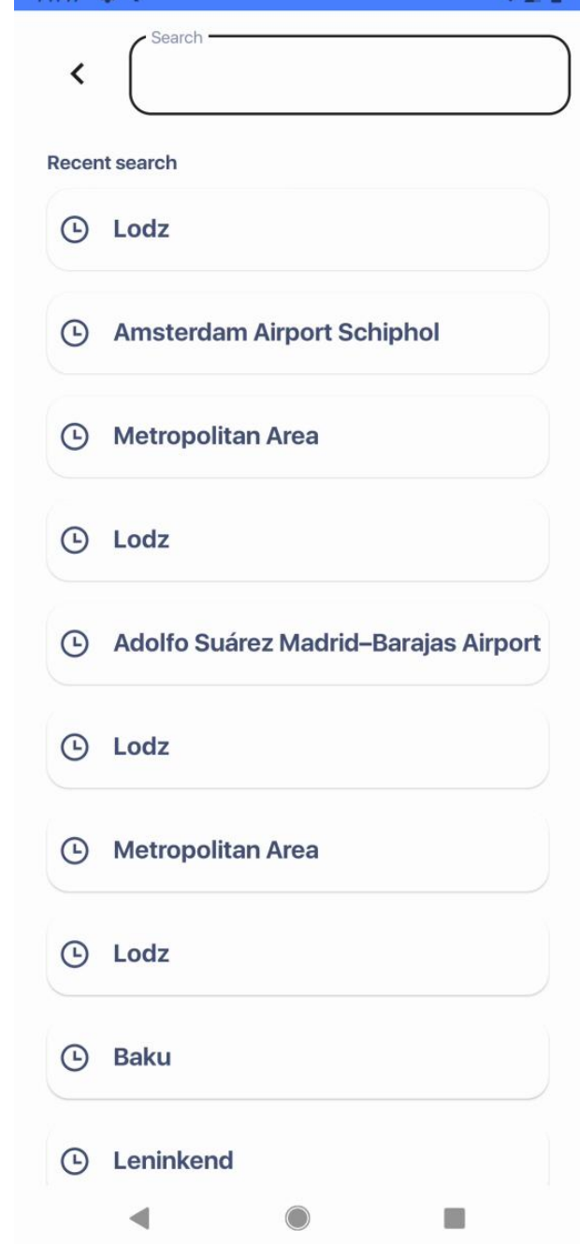
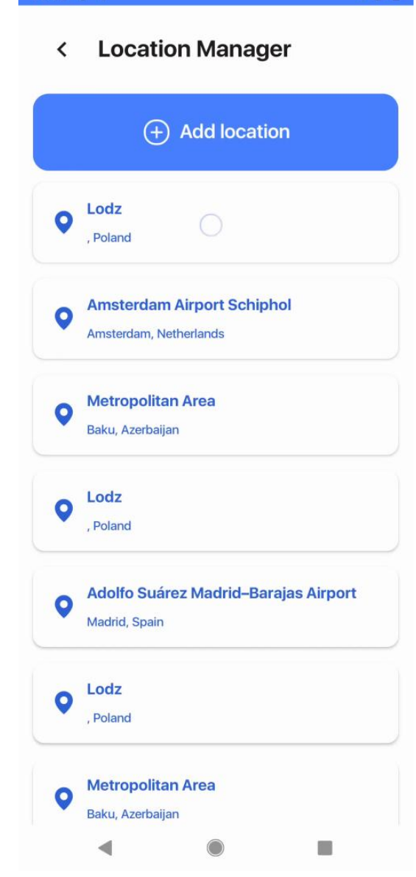
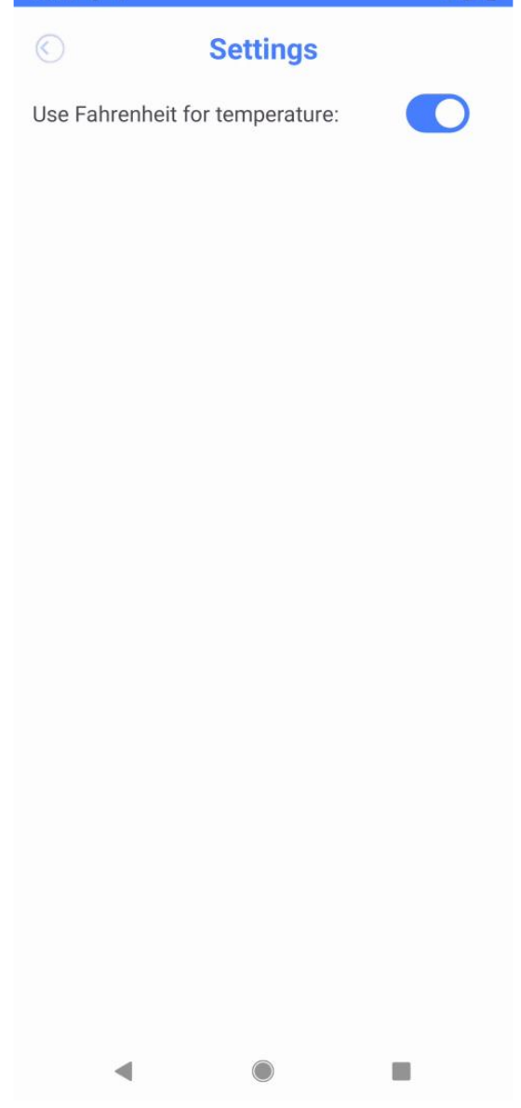
Project objectives
Objectives & implemented scope
Main objective
Build a maintainable Android weather client with REST data, local storage, and a structured multi-screen interface.
Out of current scope
GPS location, live AQI, offline forecast cache, notifications, web/iOS clients, and user accounts.
• Layered architecture with presentation, domain-oriented, and data responsibilities
• WeatherAPI.com integration for search and forecast retrieval
• Room and Preferences DataStore for local persistence
• Navigation between Splash, Home, Search, Location Manager, Settings, Details, and Hourly screens
• Custom visual components: wind compass, sunrise/sunset, and hourly chart
WoWeather thesis defence | 03
Notes:
Summarize the thesis scope. Be clear that planned features are deliberately separated from implemented features, which makes the documentation traceable to the actual repository.

Slide 4
Requirements analysis
Core requirements
Functional requirements
Non-functional requirements
Single end-user role
• Display current weather for a selected city
• Show hourly forecast and multi-day forecast
• Search, save, select, and delete locations
• Open Today/Daily details and single-hour details
• Manual refresh and connectivity warning
• Android API 24+ compatibility
• Separation of UI, use-case, and data-access responsibilities
• Hilt dependency injection
• Coroutines and Flow for asynchronous work
• Safe Args and binding for type-safe UI flows
• No login or registration
• WeatherAPI key identifies app requests
• City selections and preferences are stored locally
• External weather queries are sent only when needed
Design principle: each requirement maps to a concrete implemented screen, class, or data flow.
WoWeather thesis defence | 04
Notes:
Explain the application is scoped around one end-user. The functional requirements cover the primary weather journey; non-functional requirements focus on maintainability and Android development quality.

Slide 5
Technical background
Technology stack
Kotlin
Retrofit + Gson
OkHttp
Primary language
REST + JSON
HTTP client
Room
DataStore
Hilt
Saved cities / history
City + unit preference
Dependency injection
Coroutines / Flow
Navigation + Safe Args
Glide + Lottie + Chart
Async streams
Type-safe screens
Visual UX
Build configuration: minSdk 24, compile/target SDK 35, JVM target 17, Data Binding + View Binding.
WoWeather thesis defence | 05
Notes:
Walk through the technologies as groups: networking, local persistence, architecture, asynchronous work, navigation, and visual components. Mention that the stack was chosen to fit a native Android Kotlin application.

Slide 6
Architecture
System architecture
Presentation layer
MainActivity · Fragments · ViewModels · Adapters
Domain-oriented layer
Use cases · Repository interfaces · Domain/UI models
Data layer
Repository implementations · Sources · Services · DTOs · Mappers
WeatherAPI.com
remote REST service
Room DB + DataStore
local persistence
WoWeather thesis defence | 06
Notes:
Describe the app as single-module but layered. The goal of the architecture is to keep fragments away from direct network or database calls and to put object construction in Hilt modules.

Slide 7
Remote data path
Forecast data flow
User
HomeFragment
HomeViewModel
LocationUseCase
Repository
WeatherAPI.com
1. City token is read from DataStore
2. Forecast request is made with DAYS = 7
3. Retrofit returns DTOs
4. Mappers convert DTOs to UI models
5. ViewModel emits Resource.Success to the UI
State model
Loading → Success → Error
UI result
Current + hourly + daily forecast
WoWeather thesis defence | 07
Notes:
Use this slide to describe the main forecast path. The user opens Home, the city token is observed, ViewModel calls a use case, the repository uses Retrofit, and the response is mapped back to UI models.

Slide 8
Data layer
Local persistence & preferences
Room database
Preferences DataStore
Why both?
• SavedCityDTO: id, name, region, country, token
• RecentSearchesDTO: id, name, region, country
• Used by Location Manager and Search screens
• city_selected: first-launch routing flag
• city_token: WeatherAPI-compatible token
• isFahrenheitSelected: unit preference
• Room stores lists of entities
• DataStore stores simple key-value state
• Together they support continuity across app launches
WoWeather thesis defence | 08
Notes:
Explain that Room and DataStore solve different problems. Room handles structured lists, while DataStore handles small preferences that affect routing and temperature formatting.

Slide 9
Mobile interface
Implemented user journey
Search
Home
Details
Locations
Settings
First launch → choose city → load forecast → inspect day/hour → manage places → change units
WoWeather thesis defence | 09
Notes:
Walk through the actual screens from the demonstration. This is the complete core journey: city selection, forecast view, detail view, saved locations, and unit settings.

Slide 10
What is notable?
Implementation highlights
MVVM-style state handling
BaseViewModel exposes screen state and one-off effects.
Connectivity observation
MainActivity shows a blocking dialog when the network becomes unavailable.
Search debounce
Search waits 300 ms and cancels the previous coroutine before calling the API.
Visual weather components
WindCompassView, SunriseView, and an MPAndroidChart hourly temperature line chart.
Navigation + Safe Args
Details receive city, weather type, date; Hourly receives a Parcelable HourUiModel.
Manual refresh
Home and Details trigger explicit forecast reloads and loading UI.
These features show both Android platform use and attention to user experience.
WoWeather thesis defence | 10
Notes:
Highlight implementation details that demonstrate engineering work: reactive state handling, API debounce, type-safe navigation, connectivity management, and custom visual components.

Slide 11
Validation
Validation & current limitations
Manual validation confirmed
Known limitations
• First launch routes to Search when no city is selected
• Location selection stores data and loads Home forecast
• Saved locations can be selected or deleted
• Fahrenheit switch updates relevant screens
• Refresh buttons start new forecast requests
• Network loss displays a non-cancelable warning
• Live AQI is not implemented; displayed AQI is generated for prototype UI
• No offline cache of the last successful forecast
• API key is hardcoded in the current source
• Automated tests are limited to the default template unit test
• No GPS/current-device location or completed notification feature
Important distinction: the thesis states what is implemented, partial, and planned.
WoWeather thesis defence | 11
Notes:
This slide is useful for defence questions. Be transparent: the project works as an academic prototype, but production hardening would require testing, secure configuration, offline caching, and cleanup of prototype features.

Slide 12
Closing
Results, conclusion & future work
Delivered result
A functional Android weather client with REST integration, local persistence, dependency injection, navigation, and custom weather UI.
Strong point
Clear separation between UI screens, use cases, repositories, and data sources makes the app extendable.
Next improvements
• Replace AQI prototype with live data
• Move API configuration out of version control and rotate exposed key
• Cache the latest forecast for offline reading
• Add mapper/use-case/ViewModel tests and Espresso navigation tests
• Fix data-label mismatches and add deduplication rules
• Design a separate dark-theme palette and verify accessibility
Thank you
WoWeather demonstrates a complete core flow and provides a solid base for production hardening.
WoWeather thesis defence | 12
Notes:
Close by emphasizing the result: the core user journey is complete and the app is maintainable. Then acknowledge future work and invite questions.

